Slide 1
CHAT CONNECT
SRIKANNIGAPRIYADHARSHINI.R-812022205050
ABISHA.A-812022205001
PRICILA.S-812022205037
VIYASHINI.J-812022205059

Slide 2
DESCRITION
This presentation introduces Chat Connect, a powerful communication platform designed to enhance real-time messaging, collaboration, and customer engagement. With its seamless integration of chat, video calls, and AI-powered assistance, Chat Connect empowers users and businesses to foster stronger connections, improve response times, and streamline workflows.

Slide 3
DESCRIPTION
Key Features:
Instant Messaging: Real-time, secure communication for teams, clients, and customers.
AI Chatbots: Intelligent automation for quick responses, 24/7 support, and lead generation.
Collaborative Tools: File sharing, task management, and collaborative spaces for efficient teamwork.
Cross-Platform Access: Connect from anywhere—mobile, desktop, or web-based interfaces.

Slide 4
ADVANTAGES
Instant Communication
Chat Connect enables real-time messaging, allowing teams, clients, and customers
to communicate instantly without delays. This leads to faster decision-making and problem resolution.
Enhanced Collaboration
With group chats, file sharing, and integrated task management, teams can collaborate effortlessly,
sharing ideas and resources in one central space, leading to more efficient workflows.
24/7 Availability
Chat Connect allows businesses to offer round-the-clock support using AI-driven chatbots and
automated responses, ensuring customers get the help they need at any time, even outside business hours.

Slide 5
DISADVANTAGES
Overload of Information
The constant influx of real-time messages can lead to information overload, especially
in busy work environments. This can overwhelm users, making it harder to prioritize
important tasks and manage notifications effectively.
Reduced Face-to-Face Interaction
Excessive reliance on text-based communication may lead to a decline in personal, face-to-face
interactions, which can affect team bonding, emotional connections, and non-verbal communication
cues (e.g., body language, tone of voice).
Miscommunication
Without visual or vocal cues, text-based communication can sometimes result in
misunderstandings or lack of clarity. Tone or intent can easily be misinterpreted,
which may lead to confusion or conflict

Slide 6
IMPLEMENTATION
import socketimport threadingclass
ChatServer:
def _init_(self, host='127.0.0.1', port=55555):
self.host = host self.port = port self.server = socket.socket(socket.AF_INET, socket.SOCK_STREAM)
self.server.bind((self.host, self.port))
self.server.listen()
self.clients = []
self.nicknames = []
def broadcast(self, message):
for client in self.clients:
client.send(message) def handle(self, client):
while True:
try:
message = client.recv(1024)
self.broadcast(message)
except:
index = self.clients.index(client)

Slide 7
IMPLEMENTATION
self.broadcast(f'{nickname}
left the chat!'.encode('ascii'))
breakdef receive(self):
while True:
client, address = self.server.accept()
print(f"Connected with {str(address)}")
client.send('NICK'.encode('ascii'))
nickname = client.recv(1024).decode('ascii')
self.nicknames.append(nickname)
self.clients.append(client)
print(f'Nickname of the client is {nickname}!')
self.broadcast(f'{nickname} joined the chat!'.encode('ascii'))
client.send('Connected to the server!'.encode('ascii')
thread = threading.Thread(target=self.handle, args=(client,))
thread.start() def run(self): print("Server Started!")
self.receive()if _name_ == "_main_":
ChatServer().run()

Slide 8
IMPLEMENTATION
import socketimport threadingclass ChatServer:
def _init_(self, host='127.0.0.1', port=55555):
self.host = host
self.port = port
self.server = socket.socket(socket.AF_INET,socket.SOCK_STREAM) self.server.bind((self.host, self.port))
self.server.listen()
self.clients = []
self.nicknames = [] def broadcast(self, message):
for client in self.clients:
client.send(message)
def handle(self, client):
while True:
try:
message = client.recv(104)
client.close()

Slide 9
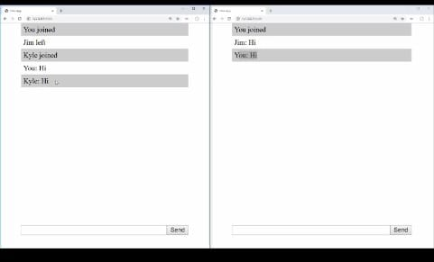
OUTPUT

